Slide 1
Financial Analysis
United Health
vs.
Cardinal Health
Notes:
Whether the values of all the ratios are “good or bad” depends largely on the industry the company is in because there are different normals across industries

Slide 2
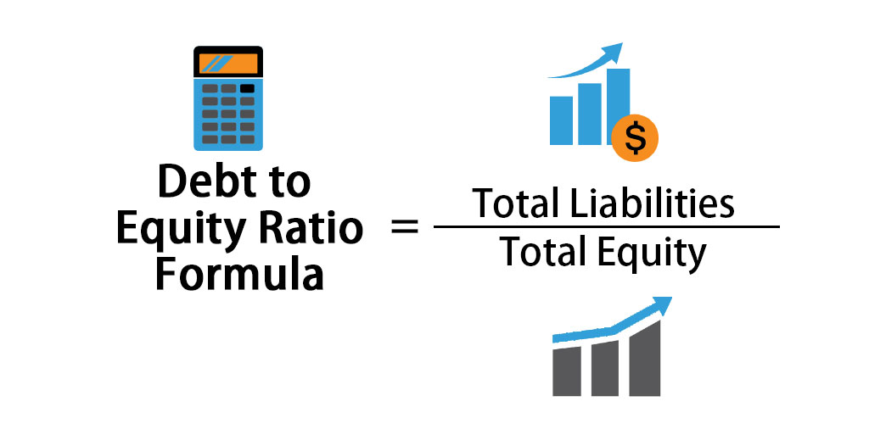
Debt to Equity Ratio
CAH racked up a lot of debt during the pandemic, and notably they always had more debt to earnings than United
What accounts for the explosion of debt, they were less prepared for the pandemic
They had to take on debt during the pandemic that United did not
Debt comes at a cost, equity is different (it’s a measurement of control)

Slide 3
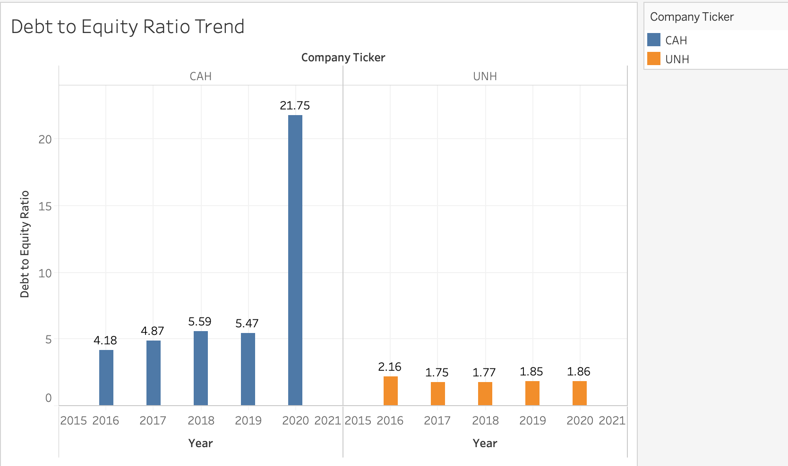
CAH
UNH

Slide 4
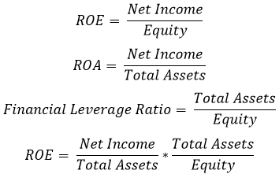
Rate of Return on Shareholders’ Equity and Assets Trends
Highly capital intensive industries have lower asset turnover ratios
Need much higher profit margins to achieve competitive ROAs
Investor owned hospitals have higher profit margins
Media reported that hospitals that were relying on routine procedures for cash flow generated great loss of revenue because they didn’t adjust their financial planning to the pandemic emergency procedures
Preventive procedures and emergency procedures have been difficult to manage
Revenue on doctor goes down, but united is collecting the money and not paying out on these procedures (their profits still go up)
Majority of patients admitted were elderly, over 85% of the deaths were patients over the age of 65. They are either on medicare or medicare funded insurance, which doesn’t translate into insurance payments—they hit the federal government, and their reimbursements to hospitals are contractually controlled
They have contracts with social security, and a lot of the costs were not covered by reimbursements
How much of the covid relief bill was supplement by that?
Employees who had insurance through their employer are now generating

Slide 5
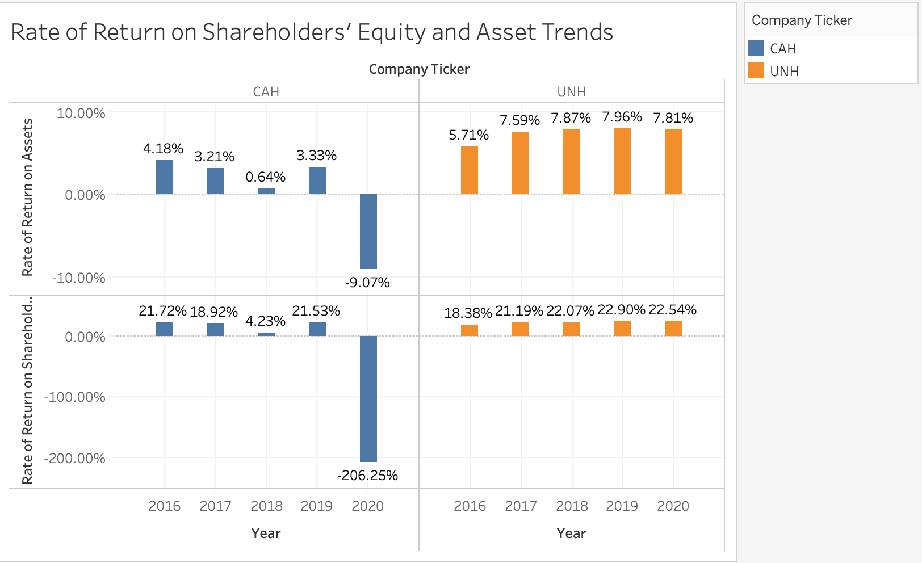


CAH
UNH
ROA hospitals:
High = 16.1%
Avg = 11.94%
Low = 4.43%
ROE hospitals:
High = 21.76%
Avg = 5.73%
Low = 1.74%
Notes:
*want both of these to be higher because you are getting “more for your money”

Slide 6
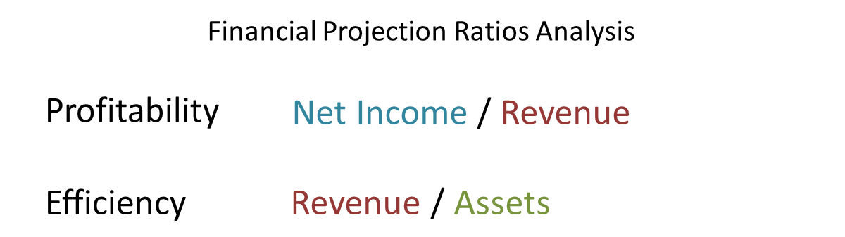

Slide 7
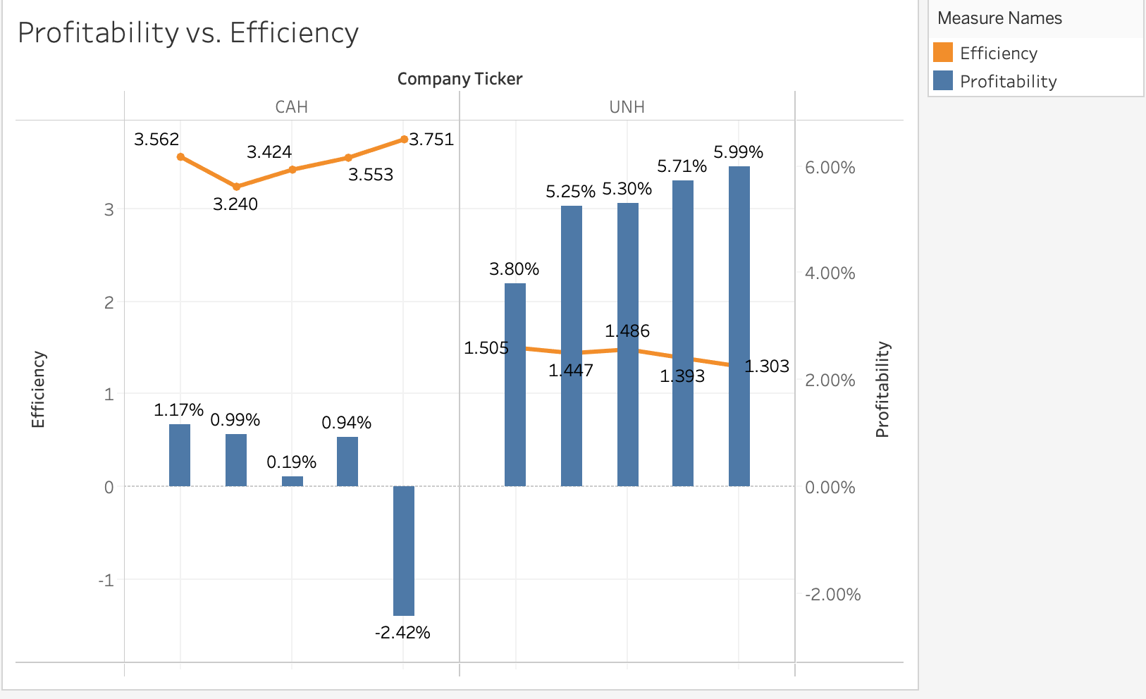
CAH
UNH

Slide 8
Return on Assets vs. Cash Return on Assets
Cash return on assets = actual cash flow generated not influenced by net income
Good for comparing companies in the same industry
- Cash position is rather than a pool based (what the company would look like from an income perspective if it was measuring on cash)
o The cash ROA for both companies is better than ROA, from a cash perspective they are not in a bad place

Slide 9
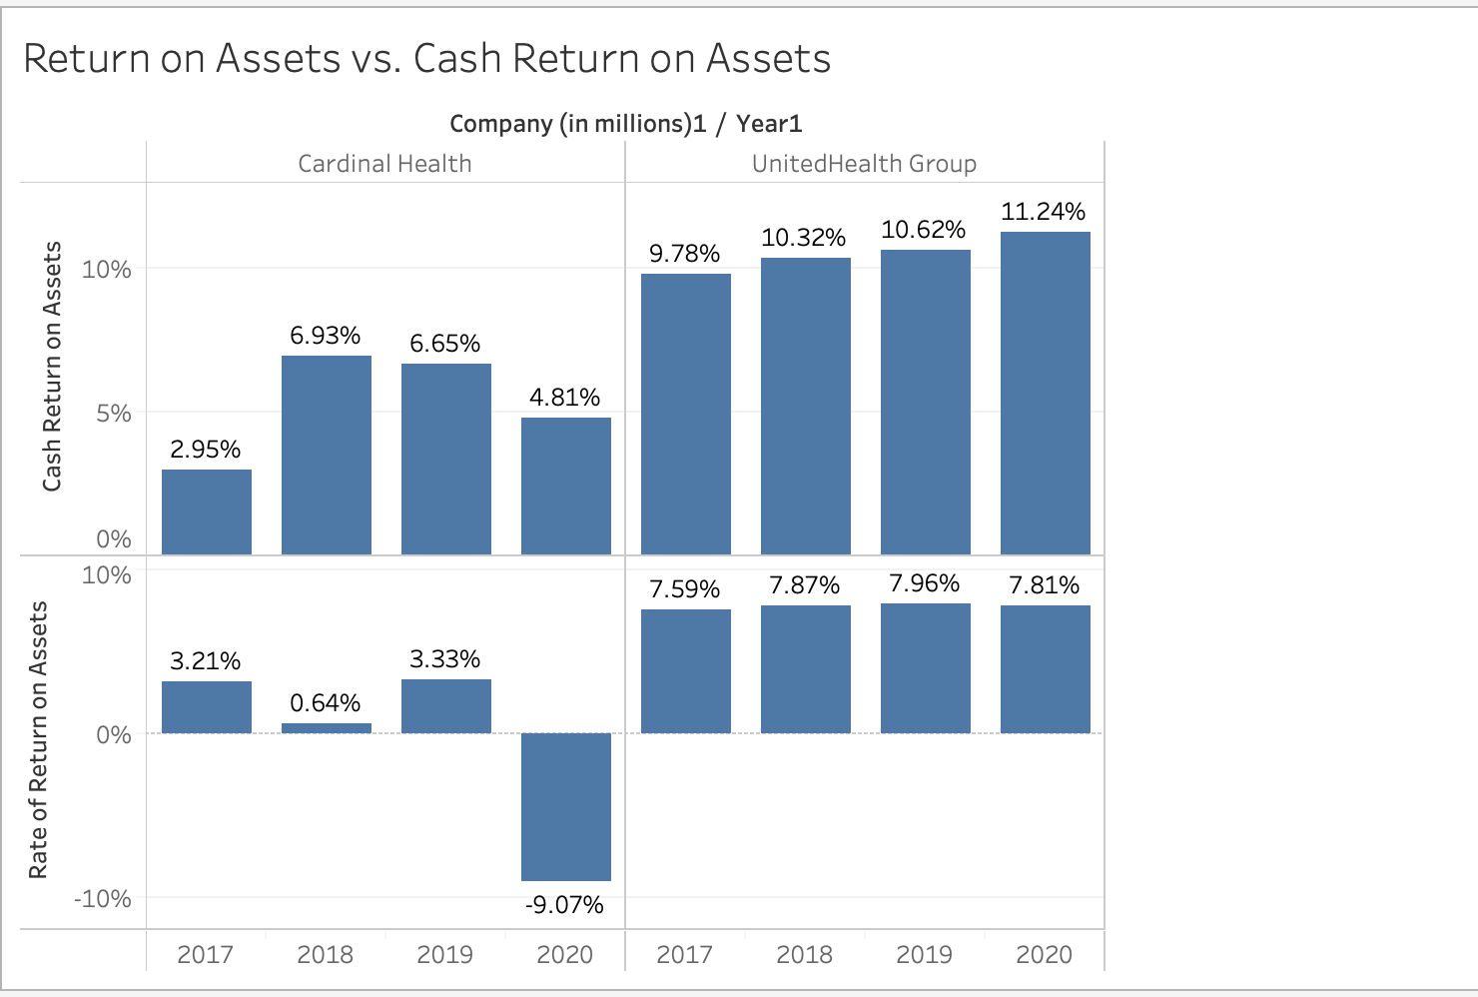
CAH
UNH

Slide 10
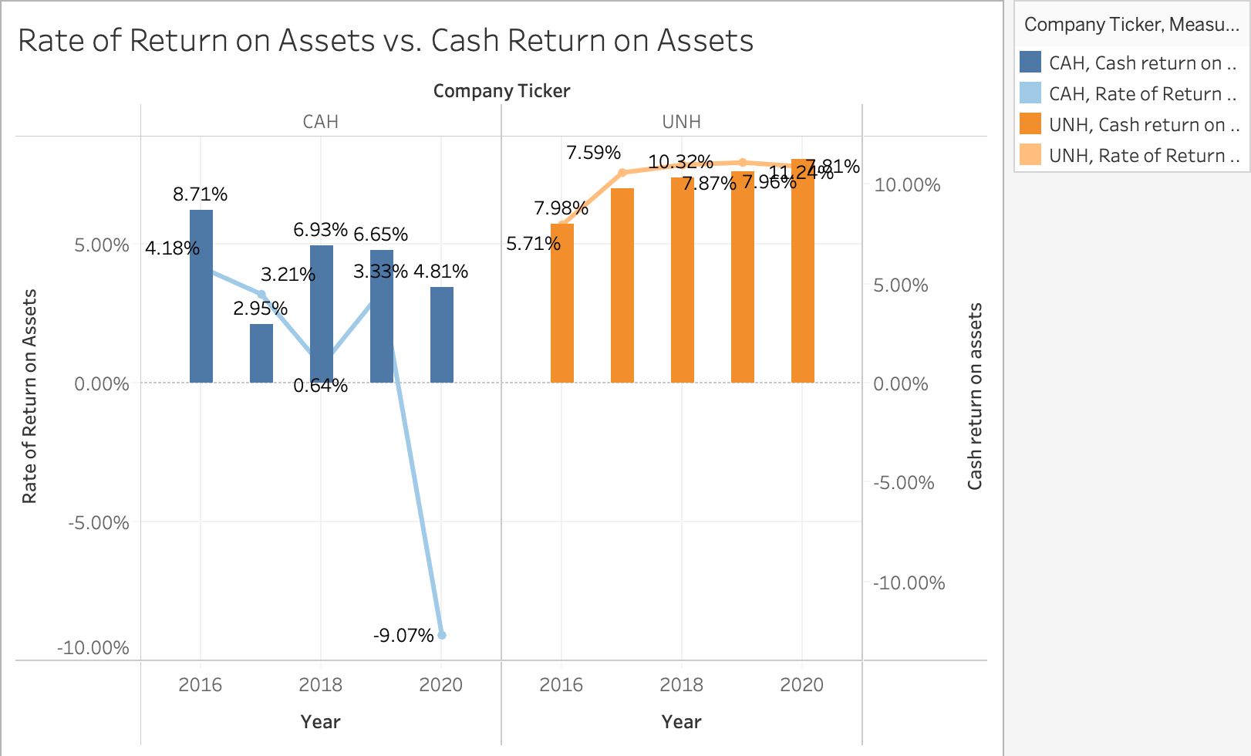
CAH
UNH

Slide 11
Average Cash Return on Assets

Slide 12
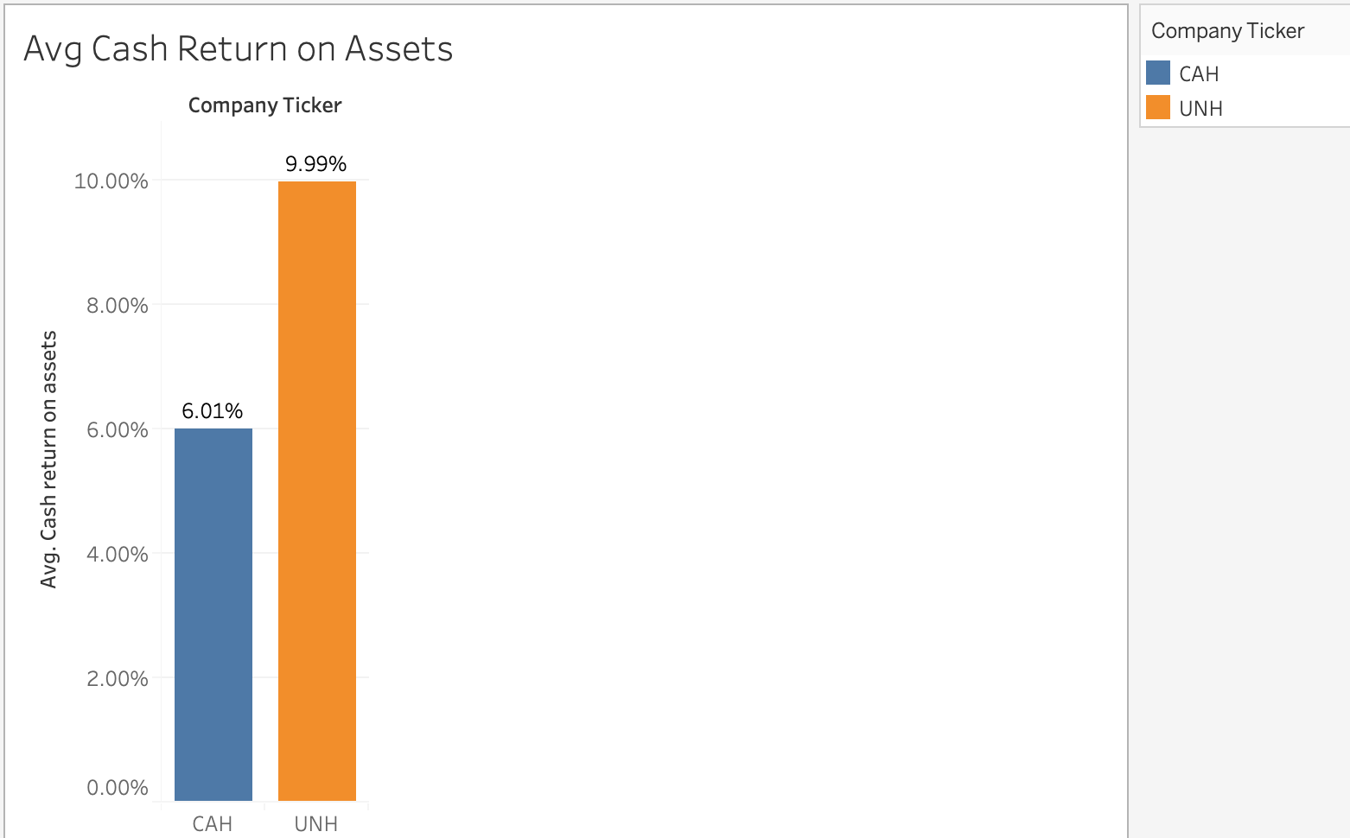
CAH
UNH

Slide 13
Average ROA

Slide 14
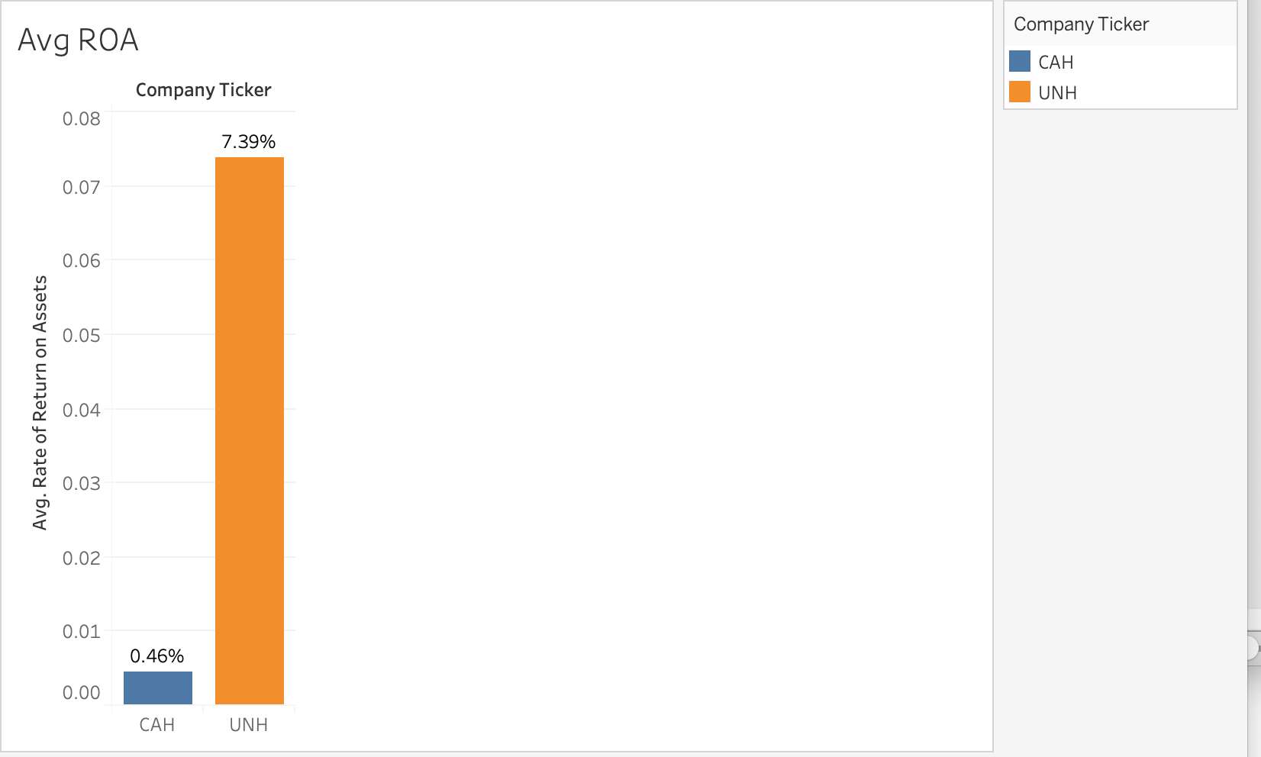
CAH
UNH

Slide 15
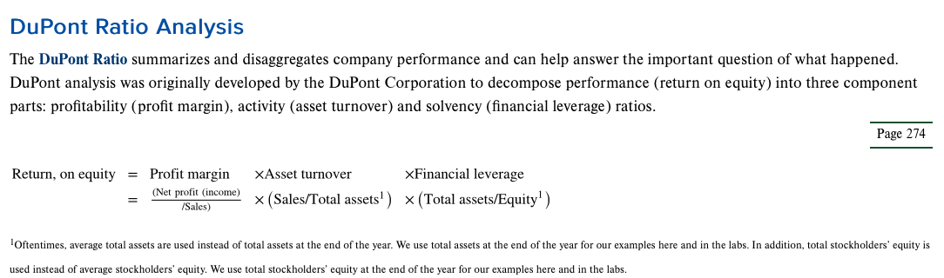

Slide 16
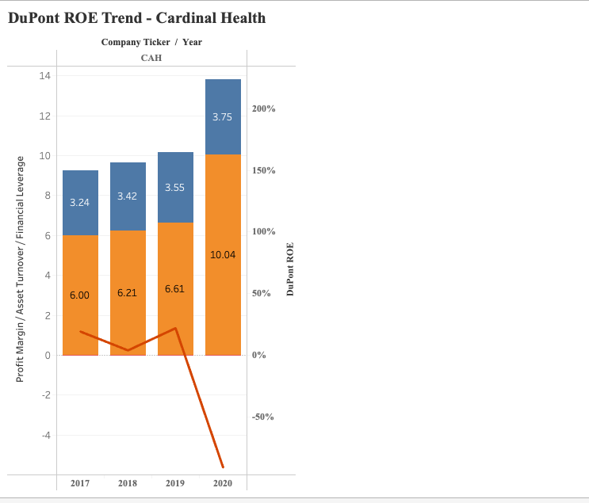
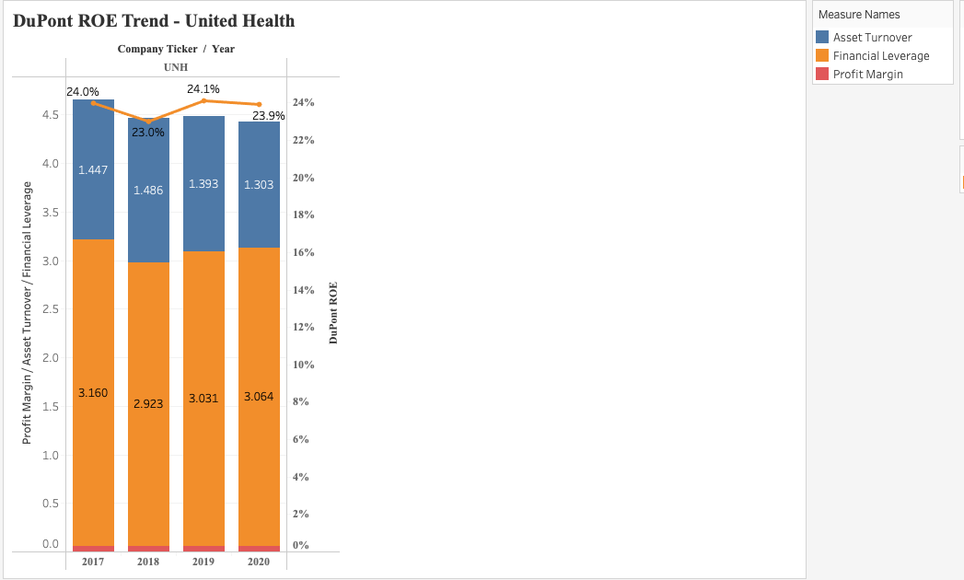

CAH
UNH

